Slide 1
Database Systems
Lecture 2-Chapter # 8
Relational algebra
Alina Arshad
alina.arshad@nu.edu.pk

Slide 2
Relational Algebra Operations from Set Theory: UNION
UNION Operation
Binary operation, denoted by 𝖴
The result of R 𝖴 S, is a relation that includes all tuples that are either in R or in S or in both R and S
Duplicate tuples are eliminated
The two-operand relations R and S must be “type compatible” (or UNION compatible)
R and S must have same number of attributes
Each pair of corresponding attributes must be type compatible (have same or compatible domains)

Slide 3
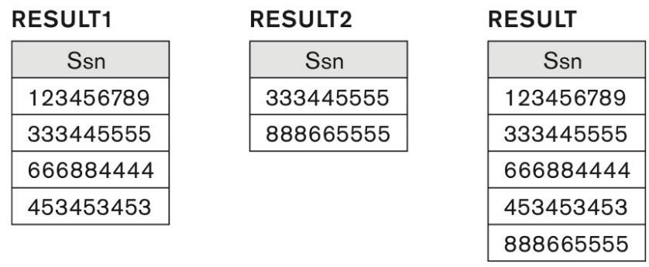
Relational Algebra Operations from Set Theory: UNION
Example:
To retrieve the social security numbers of all employees who either work in department 5 (RESULT1 below) or directly supervise an employee who works in department 5 (RESULT2 below)
We can use the UNION operation as follows:
DEP5_EMPS ← σ_{DNO=5} (EMPLOYEE)
RESULT1 ← π _{SSN}(DEP5_EMPS)
RESULT2(SSN) ← π_{SUPERSSN}(DEP5_EMPS)
RESULT ← RESULT1 𝖴 RESULT2
The union operation produces the tuples that are in either RESULT1 or RESULT2 or both

Slide 4
Union Operation (Example)
Depositor Relation
Borrow Relation
CUSTOMER_NAME | ACCOUNT_NO
Johnson | A-101
Smith | A-121
Mayes | A-321
Turner | A-176
Johnson | A-273
Jones | A-472
Lindsay | A-284
CUSTOMER_NAME | LOAN_NO
Jones | L-17
Smith | L-23
Hayes | L-15
Jackson | L-14
Curry | L-93
Smith | L-11
Williams | L-17

Slide 5
Union Operation (Example)
Output:
Input:
∏ CUSTOMER_NAME (BORROW) 𝖴
∏ CUSTOMER_NAME (DEPOSITOR)
CUSTOMER_NAME
Johnson
Smith
Hayes
Turner
Jones
Lindsay
Jackson
Curry
Williams
Mayes

Slide 6
Relational Algebra Operations from Set Theory
Type Compatibility of operands is required for the binary set operation UNION 𝖴, (also for INTERSECTION ∩, and SET DIFFERENCE –, see next slides)
R1(A1, A2, ..., An) and R2(B1, B2, ..., Bn) are type compatible if:
they have the same number of attributes, and
the domains of corresponding attributes are type
compatible (i.e. dom(Ai)=dom(Bi) for i=1, 2, ..., n).
The resulting relation for R1𝖴R2 (also for R1∩R2, or R1–R2, see next slides) has the same attribute names as the first operand relation R1 (by convention)

Slide 7
Relational Algebra Operations from Set Theory: INTERSECTION
INTERSECTION is denoted by ∩
The result of the operation R ∩ S, is a relation that includes all tuples that are in both R and S
The attribute names in the result will be the same as the attribute names in R
The two-operand relations R and S must be “type compatible”

Slide 8
Intersection Operation
set intersection
Example: Using the above DEPOSITOR table and BORROW table
Input:
∏ CUSTOMER_NAME (BORROW) ∩ ∏ CUSTOMER_NAME (DEPOSITOR)
Output:
CUSTOMER_NAME
Smith
Jones

Slide 9
Relational Algebra Operations from Set Theory: SET DIFFERENCE (cont.)
SET DIFFERENCE (also called MINUS or EXCEPT) is denoted by –
The result of R – S, is a relation that includes all tuples that are in R but not in S
The attribute names in the result will be the same as the attribute names in R
The two-operand relations R and S must be “type compatible”

Slide 10
Difference(Minus) Operation
Example: Using the above DEPOSITOR table and BORROW table
Input:
∏ CUSTOMER_NAME (BORROW) - ∏ CUSTOMER_NAME (DEPOSITOR)
Output:
CUSTOMER_NAME
Jackson
Hayes
Willians
Curry

Slide 11
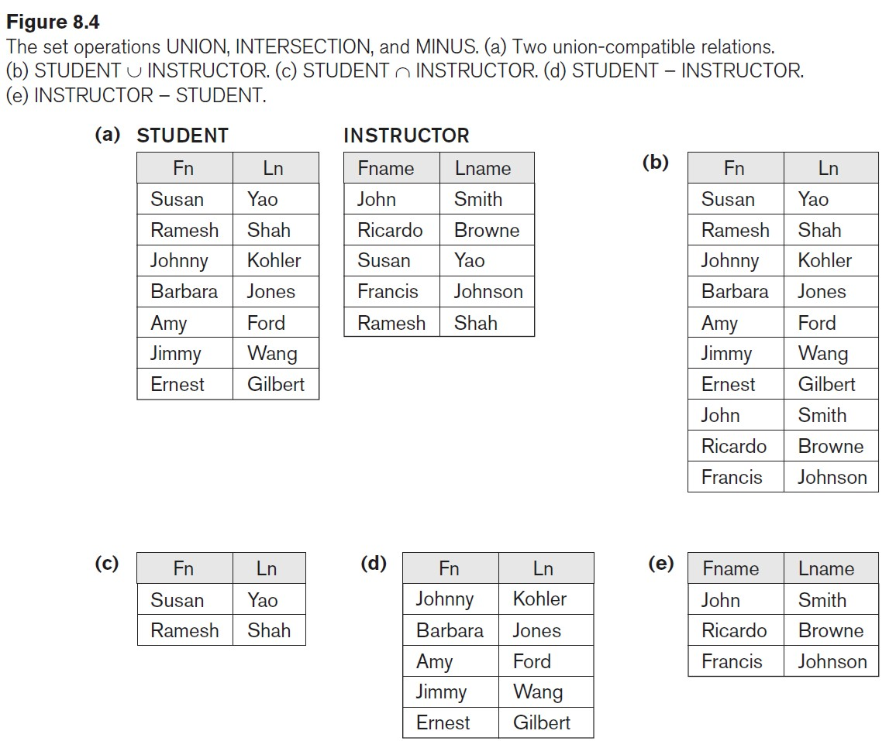
Example to illustrate the result of UNION, INTERSECT, and DIFFERENCE

Slide 12
Relational Algebra Operations from Set Theory: CARTESIAN PRODUCT
CARTESIAN (or CROSS) PRODUCT Operation
This operation is used to combine tuples from two relations in a combinatorial fashion.
Denoted by R(A1, A2, . . ., An) x S(B1, B2, . . ., Bm)
Result is a relation Q with degree n + m attributes:
Q(A1, A2, . . ., An, B1, B2, . . ., Bm), in that order.
The resulting relation state has one tuple for each combination of tuples one from R and one from S.
Hence, if R has n_{R} tuples (denoted as |R| = n_{R} ), and S has n_{S} tuples, then R x S will have n_{R} * n_{S} tuples.
The two operands do NOT have to be "type compatible”

Slide 13
A1 | A2
1 | 2
3 | 4
B1 | B2
C | D
E | F
A1 | A2 | B1 | B2
1 | 2 | C | D
1 | 2 | E | F
3 | 4 | C | D
3 | 4 | E | F

Slide 14
Relational Algebra Operations from Set Theory: CARTESIAN PRODUCT (cont.)
Generally, CROSS PRODUCT is not a meaningful operation
Can become meaningful when followed by other operations
Example (not meaningful):
FEMALE_EMPS ← σ _{SEX=’F’}(EMPLOYEE)
EMPNAMES ← π _{FNAME, LNAME, SSN} (FEMALE_EMPS)
EMP_DEPENDENTS ← EMPNAMES x DEPENDENT
EMP_DEPENDENTS will contain every combination of EMPNAMES and DEPENDENT
whether or not they are actually related

Slide 15
EMPLOYEE
Dependent
SSN | FNAME | LNAME | SEX
123 | Alice | Brown | F
456 | Bob | Smith | M
789 | Carol | Davis | F
SSN | DEPENDENT_NAME | RELATION
123 | Lily | Daughter
456 | James | Son
789 | Sarah | Daughter
EMP_DEPENDENTS
FNAME | LNAME | SSN (Employee) | SSN (Dependent) | DEPENDENT_NAME | RELATION
Alice | Brown | 123 | 123 | Lily | Daughter
Alice | Brown | 123 | 456 | James | Son
Alice | Brown | 123 | 789 | Sarah | Daughter
Carol | Davis | 789 | 123 | Lily | Daughter
Carol | Davis | 789 | 456 | James | Son
Carol | Davis | 789 | 789 | Sarah | Daughter

Slide 16
Relational Algebra Operations from Set Theory: CARTESIAN PRODUCT (cont.)
To keep only combinations where the DEPENDENT is related to the EMPLOYEE, we add a SELECT operation as follows
Example (meaningful):
FEMALE_EMPS ← σ _{SEX=’F’}(EMPLOYEE)
EMPNAMES ← π _{FNAME, LNAME, SSN} (FEMALE_EMPS)
EMP_DEPENDENTS ← EMPNAMES x DEPENDENT
ACTUAL_DEPS ← σ _{SSN=ESSN}(EMP_DEPENDENTS)
^{RESULT ← π} FNAME, LNAME, DEPENDENT_NAME(ACTUAL_DEPS)
RESULT will now contain the name of female employees and their dependents

Slide 17
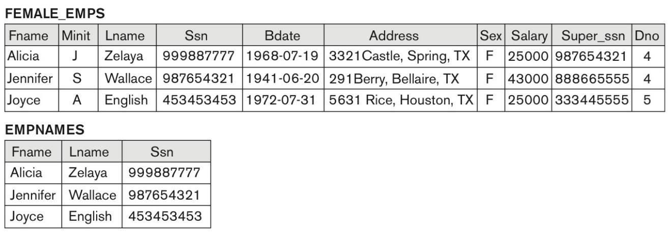
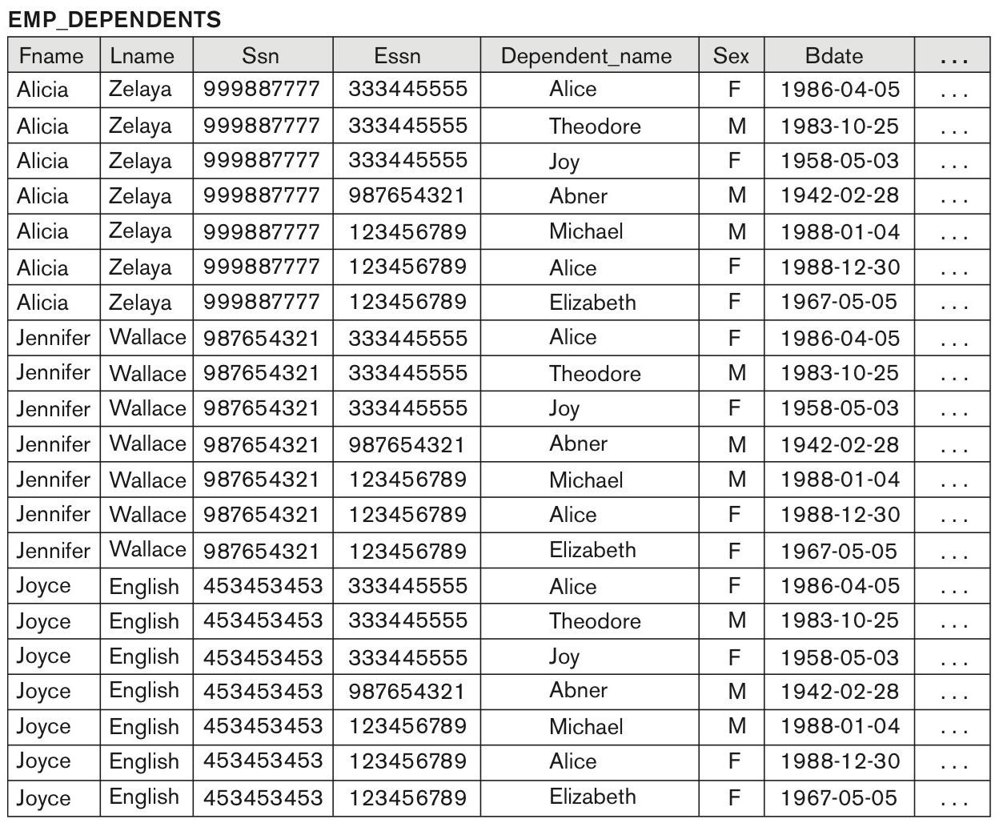
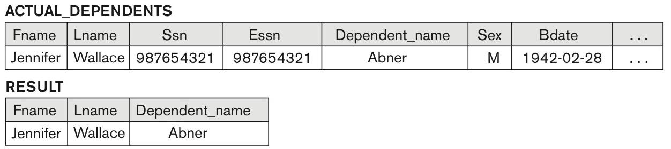
FEMALE_EMPS ← σ _{SEX=’F’}(EMPLOYEE) EMPNAMES ← π _{FNAME, LNAME, SSN} (FEMALE_EMPS) EMP_DEPENDENTS ← EMPNAMES x DEPENDENT ACTUAL_DEPS ← σ _{SSN=ESSN}(EMP_DEPENDENTS)
^{RESULT ← π} FNAME, LNAME, DEPENDENT_NAME
(ACTUAL_DEPS)
Figure 8.5 The CARTESIAN PRODUCT (CROSS
PRODUCT) operation.

Slide 18
Binary Relational Operations: JOIN
JOIN Operation (denoted by )
The sequence of CARTESIAN PRODECT followed by SELECT is used quite commonly to identify and select related tuples from two relations
A special operation, called JOIN combines this sequence into a single operation
This operation is very important for any relational database with more than a single relation, because it allows us combine related tuples from various relations
The general form of a join operation on two relations R(A1, A2, . . ., An) and S(B1, B2, . . ., Bm) is:
R
<join condition>^{S}
where R and S can be any relations that result from general relational algebra expressions.

Slide 19
Binary Relational Operations: JOIN (cont.)
Example: Suppose that we want to retrieve the name of the manager of each department.
To get the manager’s name, we need to combine each DEPARTMENT tuple with the EMPLOYEE tuple whose SSN value matches the MGRSSN value in the department tuple.
We do this by using the join operation.
DEPT_MGR ← DEPARTMENT MGRSSN=SSN ^{EMPLOYEE}
MGRSSN=SSN is the join condition
Combines each department record with the employee who manages the department
The join condition can also be specified as DEPARTMENT.MGRSSN=
EMPLOYEE.SSN

Slide 20
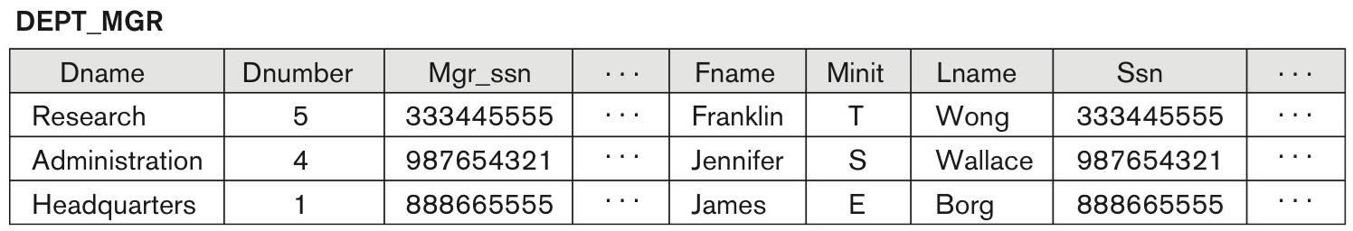
DEPARTMENT^{|X|}
Mgr_ssn=Ssn^{EMPLOYEE.}
Figure 8.6 Result of the JOIN operation DEPT_MGR ←

